Slide 1
COMP 201 OPEN SOURCE & SYSTEM ADMINISTRATION
DANIEL OBUOBI
BASIC OF UNIX & FILE SYSTEM

Slide 2
Basics of UNIX

Slide 3
Getting Started With UNIX Section A: Objectives
After studying this lesson, you should be able to:
Define operating systems in general
Describe what a UNIX shell is
Describe the options for connecting to a UNIX system
Log on to and log out of UNIX

Slide 4
Getting Started With UNIX Section A: Objectives (Contd)
After studying this lesson, you should be able to:
Use the date, cal, who, finger, clear, man, whatis, whereis, whoami, and passwd commands
Recall a command from the command history
Use Pine to check email on CSE

Slide 5
What is an Operating System?
An operating system (OS) is the most important program that runs on a computer.
Primary purpose is to facilitate:
Easy, efficient, fair, orderly and secure use of hardware and software resources.
Allows users to employ application software, language libraries, system calls and program generation tools.

Slide 6
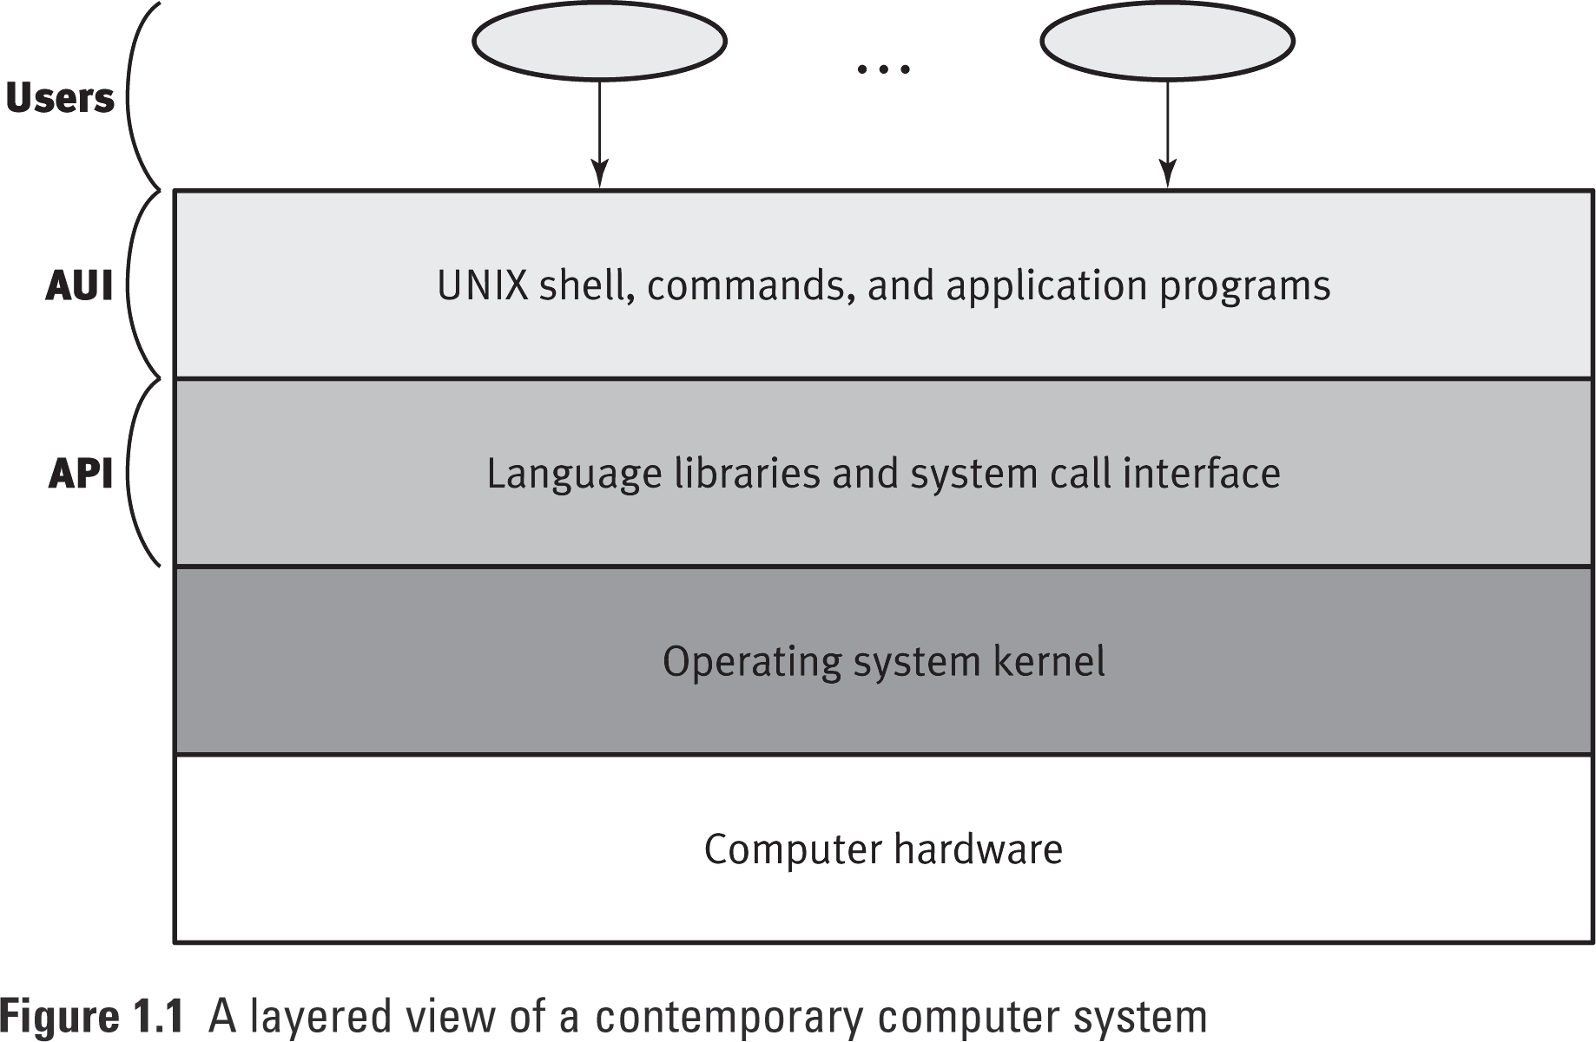
Layered View of a Computer System

Slide 7
Types of Operating Systems
Single-user, single-process system
Historic, but rare (only a few PDAs use this)
Single-user, multiprocess system
Some PCs and workstations may be configured like this. e.g., Windows 95, OS/2
Multiuser, multiprocess system
Commonly used on computers that support multiple users in organizations such as universities and large businesses . e.g. UNIX, Linux, WindowsNT Server

Slide 8
Introducing the UNIX Operating System
UNIX is a multi-user, multiprocess operating system.
A multi-user system lets many people simultaneously access and share the resources of a server computer.
A multiprocess system lets one user run more than one process at a time.
UNIX is also a portable operating system.

Slide 9
Introducing the UNIX Operating System (Contd)
Its portability means it can be used in a variety of computing environments.
Traditionally, most operating systems were written in Assembler, for a specific architecture.
VERY painful - if at all possible - to ‘port' the operating system to other architectures.
UNIX is mostly written in the C language. This alone allows UNIX to be portable to many architectures.
UNIX/LINUX runs on a wider variety of computers than any other operating system.

Slide 10
A Brief History of UNIX
A group of programmers at Bell Labs originally developed UNIX in the early 1970s.
Bell Labs distributed UNIX in its source code form, so anyone who used UNIX could customize it as needed.
Eventually, two standard version of UNIX evolved:
AT&T produced System V (1983)
University of California at Berkeley developed BSD (Berkeley System Distribution, 2BSD, 1978)

Slide 11
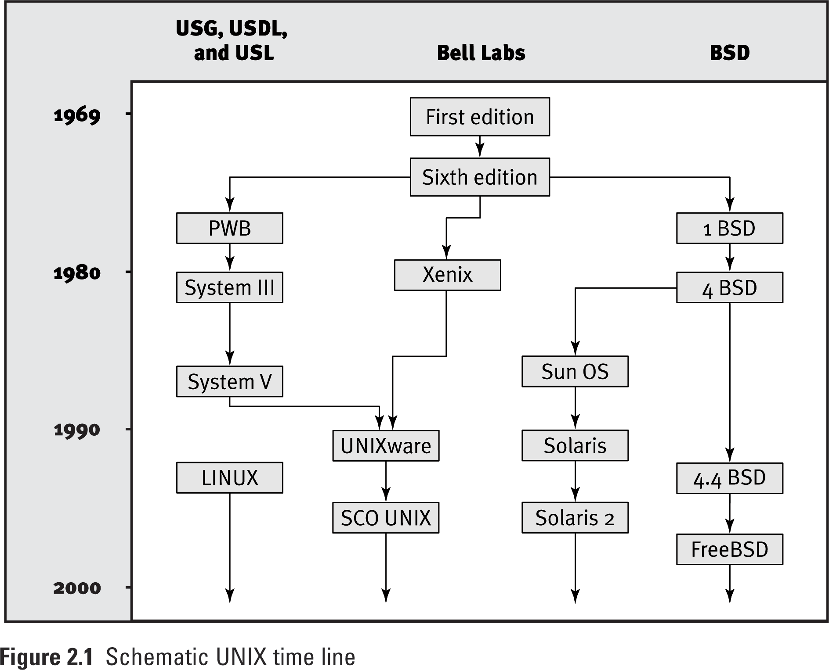

Slide 12
Layers of a UNIX System
Hardware
Kernel
System Calls
Shells, ls, cp, etc.
Netscape, vi, pine, etc.

Slide 13
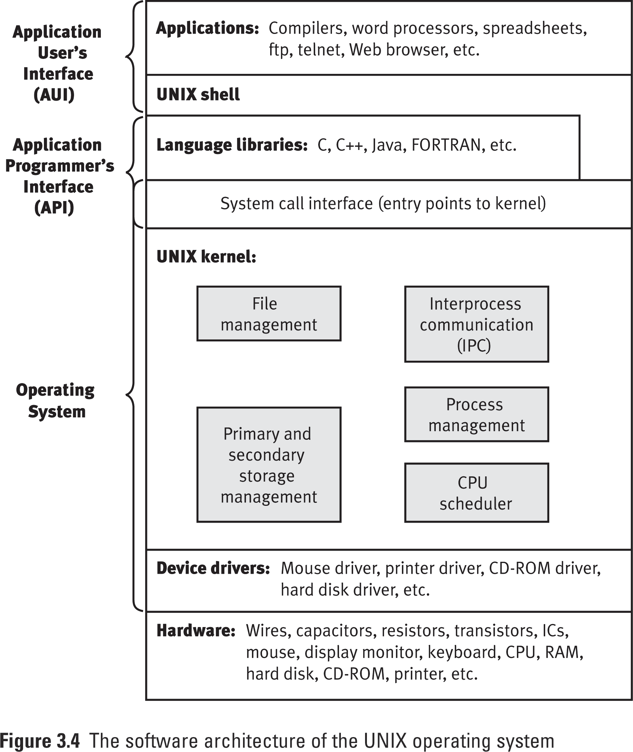
UNIX Software Architecture (Contd)

Slide 14
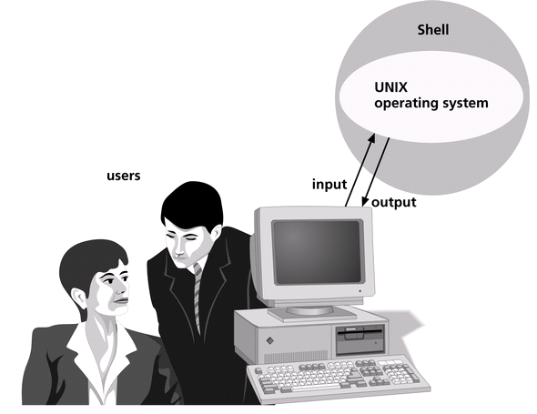
Introducing UNIX Shells
The UNIX shell is a program that starts running when you log on and interprets the commands that you enter from the keyboard.

Slide 15
Introducing UNIX Shells (Contd)
UNIX provides several shells, including the Bourne shell (sh), the Korn shell (ksh), and the C shell (csh).
The Bourne Again shell (bash), TC shell (tcsh) and Z shell (zsh) are relatively new and are more popular with LINUX systems.

Slide 16
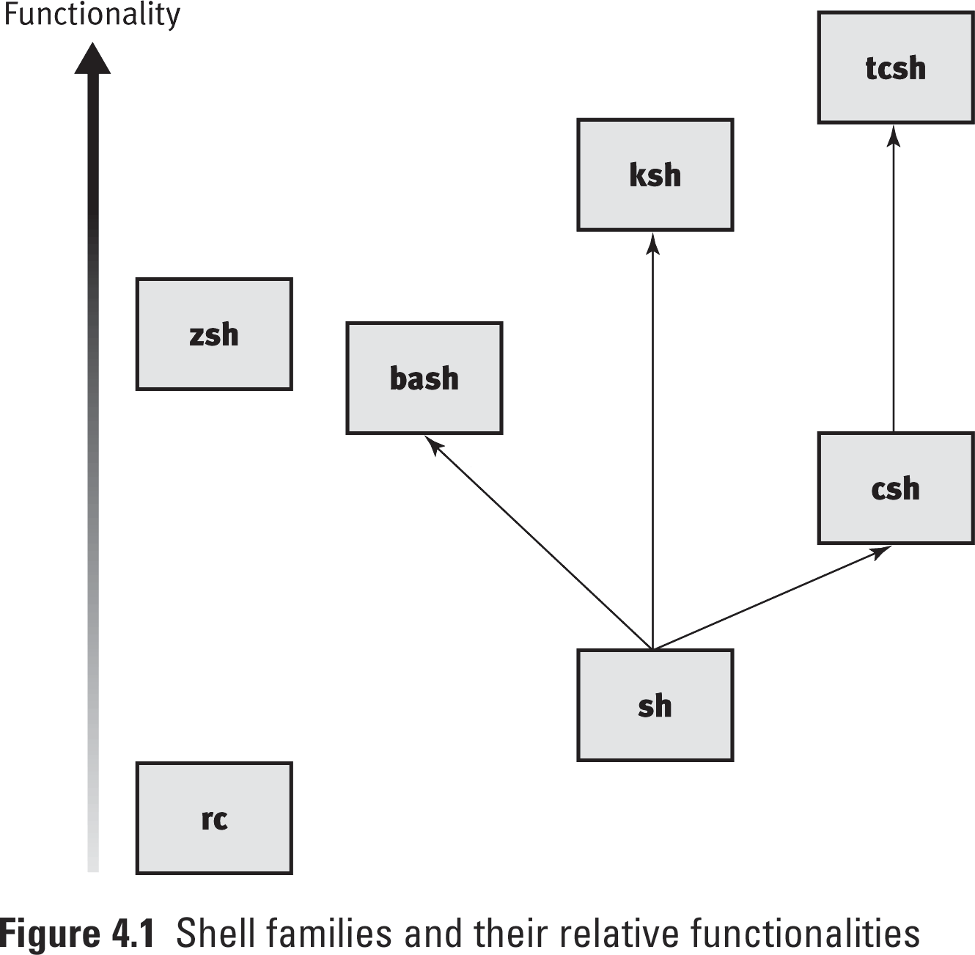
Various UNIX Shells

Slide 17
Logging On to UNIX
After you connect to a UNIX system, you must log on by entering your user name and password.
For security reasons, the password does not appear on the screen as you type it.

Slide 18
Connecting to UNIX using PuTTY or Telnet
PuTTY is a free implementation of Telnet and SSH for Win32 and Unix platforms.
Much better than using Telnet, more secure and easier to use
Telnet is a terminal emulation program for the Internet.
SSH (Secure Shell) is for UNIX/LINUX systems to provide authentication security for TCP/IP applications, such as FTP and Telnet. It can encrypt communications as they go across a network or the Internet.
Each computer on the Internet has an Internet Protocol (IP) address.
An IP address is a set of four numbers separated by periods, such as 129.93.165.2
Most systems on the Internet also have a domain name such as cse.unl.edu.

Slide 19
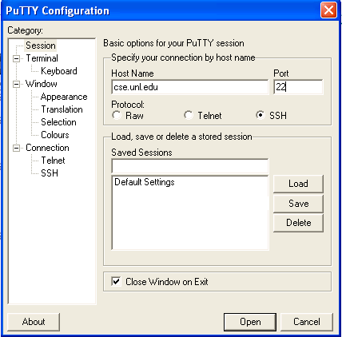
Connecting to UNIX via PuTTY

Slide 20
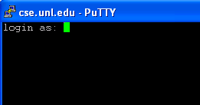
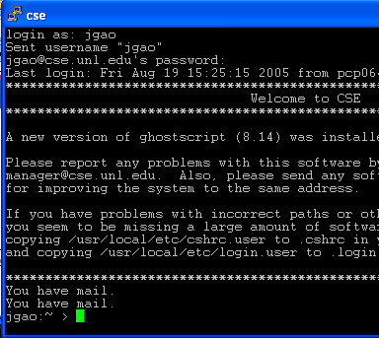
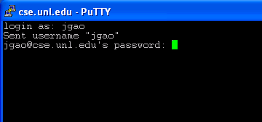
Connecting to UNIX via PuTTY (Contd)

Slide 21
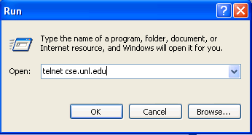
Connecting to UNIX via Telnet

Slide 22
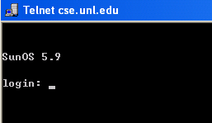
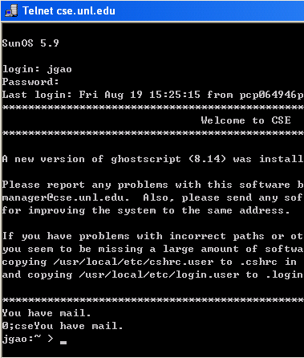
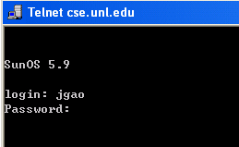
Connecting to UNIX via Telnet (Contd)

Slide 23
Entering Commands
UNIX philosophy: it assumes users know what they are doing.
UNIX is command-line based system. It is important to remember commands and their usage.
Commands in UNIX are programs.
UNIX is case-sensitive, that is, it distinguishes between uppercase and lowercase letters, so that date differs from Date
You type most UNIX commands in lowercase.

Slide 24
Structure of a UNIX command
$ command [ - option (s) ] [ option argument (s) ] [ command argument (s) ]
where:
$ is system prompt ($ for Bourne Shell, % for C shell)
command is the name of the valid UNIX command for that shell in lowercase letters
[-option(s)] is one or more modifiers that change the behavior of command
[option argument(s)] is one or more modifiers that change the behavior of [-option(s)]
[command argument(s)] is one or more objects that are affected by command, generally, files or pathnames
A space seperates command, options, option arguments and command arguments, but no space is necessary between multiple options or multiple option arguments. And a space is optional between the option and option argument.

Slide 25
Structure of a UNIX command (Contd)
$ command [ -option (s) ] [ option argument (s) ] [ command argument (s) ]
Examples:
$ ls
Contains only the command ls
$ ls -la
Contains the command ls and two options, l and a
$ ls -la m*
Contains the command ls; two options, l and a; and a command argument, m*
$ lpr -Pspr -n 3 proposal.ps
Contains the command lpr; two options, P and n; two option arguments, spr and 3; and a command argument, proposal.ps

Slide 26
The date Command
Use the UNIX date command to display the system date, which the system administrator maintains
date

Slide 27
The cal Command
Display the calendar of current month
cal
Display the calendar of 2004
cal 2004
Display the calendar of July 1775
cal 7 1775

Slide 28
The who and finger Commands
In a multi-user system, knowing who is logged on to the system may be helpful
Use the who command to see who is using the system and their current location
who
User finger command to know the detailed information for a specific user
finger username

Slide 29
The clear Command
You can use the clear command to clear your screen; it has no options or arguments.
clear

Slide 30
Command-line History
The Command-line History
Access the command history with the up and down arrow keys
Pressing the up arrow key once recalls the most recently used command
Each time you press the up arrow key, you recall an older command
Each time you press the down arrow key, you scroll forward in the command history

Slide 31
The man Program
For reference, UNIX includes an online manual that contains all commands, including their options and arguments
The man program in UNIX displays this online manual, called the man pages, for command-line assistance
man who
Press the <Space> key on the keyboard shows you more manual pages, one screen at a time
Press Ctrl+B to go back to previous screen
Press <q> to quit man pages and return to the command line prompt

Slide 32
The whatis Command
Sometimes you find that the man pages contain more information than you want to see
To display a brief summary of a command, use the whatis command
The whatis command shows only the name and brief description that appears near the top of a command’s man page
whatis who

Slide 33
The whereis Command
Locate the binary, source, and man page files for a command
whereis who

Slide 34
The whoami Command
Display the effective current username
whoami

Slide 35
Changing Passwords
A user name is unique, but not confidential, and may be provided to other users. The password, on the other hand, is confidential and secures your work on the system
Using the passwd command to change password

Slide 36
Logging Out of UNIX
Logging out ends your current process and indicates to UNIX that you are finished.
How you log out depends on the shell you are using.
For the Bourne, Korn, or Bash shells, type exit on the command line or press Ctrl+D.
In the C shell, type logout on the command line.

Slide 37
Pine: Checking Emails on CSE
You can use pine program to check your email.
Pine is probably the most extensive and friendly e-mail program available for UNIX.
To start Pine
Type pine and then press <Enter>, the following pine Main Menu screen appears.
To quit Pine
1. At almost any place in Pine, press q (Quit). You are asked: Really quit pine?
2. Press y (yes) or press <Enter> to quit.
You can also use the up and down arrow key to move the cursor to each field.

Slide 38
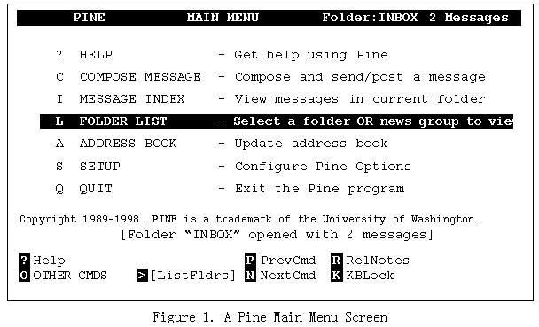

Slide 39
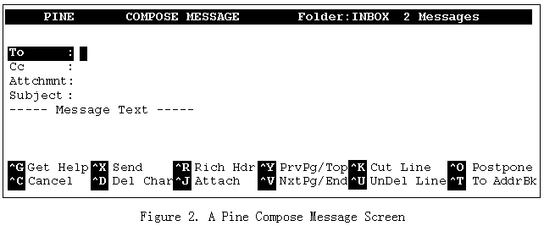
Writing a Message in Pine
To write a message, press C (Compose).
The ^ character indicates the Control key. You must hold down the Control key while you press the letter for each command.

Slide 40
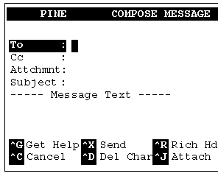
Writing and Sending a Test Message to Yourself
1. Press C (Compose). You see the Compose Message screen.
2. In the To field, type your email address and press <Enter>.
3. In the Cc field, press <Enter>.
4. In the Attachment field, press <Enter>.
5. In the Subject field, type Test and press <Enter>.
6. Below the Message Text line, type This is a test.
7. To send your message, type <Control>X.
You are asked:
Send message?
8. Press y (yes) or press <Enter>.

Slide 41
Sending/Replying/Forwarding a Message
Sending a Message
After your message is composed, type <Control>X, and then press y or press <Enter>. Your message is sent and a copy is saved to the sent-mail folder
Replying a Message
To reply to a message that you have selected at the Message Index screen or that you are viewing: Press R
You are asked whether you want to include the original message in your reply. Also, if the original message was sent to more than one person, you are asked if you want to reply to all recipients.
Forward a Message
Press F
Enter the address of your recipient and send the message as usual.

Slide 42
File and File Systems
Notes:
This lecture covers some part of Chapters 0, 7, and 8.

Slide 43
Understanding Files and Directories: Objectives
After studying this lesson, you should be able to:
File system structure
Navigating, creating and deleting…
Unix permissions

Slide 44
Understanding the UNIX File System
In UNIX, a file is the basic component for data storage.
UNIX considers everything it interacts with as a file, even attached devices such as monitors.
A file system is the UNIX system’s way of organizing files on mass storage devices such as hard and floppy disks.

Slide 45
Unix File System Structure
The file system is a hierarchical structure resembling a rooted tree, anchored at the root (“/”).
A typical UNIX system contains hundreds of files and directories.

Slide 46
Unix File System Structure (Contd)
Every item in the file system is a file (or a link).
A directory is a special kind of file can contain other files and directories (called subdirectories).
The subdirectory is considered as the child of the parent directory.
Each directory may have only one parent.

Slide 47
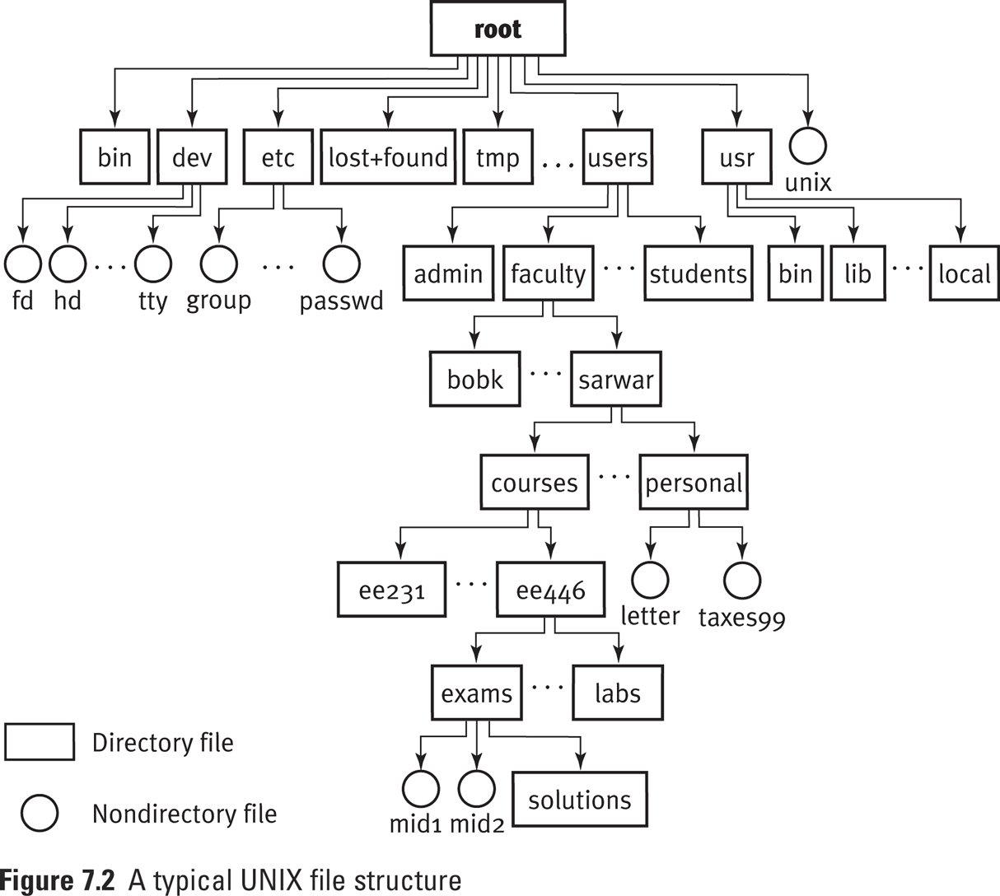

Slide 48
Some Standard Directories
Root directory (/)
at the top of the file system hierarchy. Contains some standard files and directories.
/bin
binaries, or executables, which are the programs needed to start the system and perform other essential system tasks.
/dev
Files in /dev references system devices. They access system devices and resources such as hard disks, printers, …
/etc
configuration files that the system uses when the computer starts, such as passwd (user info file), rc (scripts or directories of scripts)

Slide 49
Some Standard Directories (Contd)
/lib a collection of related files for a given language in a single file called an archive. Some libraries are also stored in the /usr/lib directory, but /lib contains all essential libraries.
/users normally used to hold the home directories of all the users of the system. On CSE a similar directory is /home.
/usr contains subdirectories that hold the UNIX utilities, tools, language libraries, and manual pages.
/tmp many programs need a temporary place to store data during processing cycle. /tmp is the traditional location for these files.

Slide 50
Home and Current Working Directories
When you log in, the UNIX system puts you in a specific directory, called your home directory.
The tilda (~) represents the home directory
Whatever directory you are presently in is known as the current working directory.
A single dot (.) denotes the current working directory
Two consecutive dots (..) denotes the parent of the current working directory

Slide 51
Absolute & Relative Paths
To describe an object in the file system you specify a path.
Paths are either absolute, starting with the root level:
/users/faculty/sarwar/courses/ee446
Or they are relative, staring with the current working directory or a user’s home directory
~/courses/ee446
./courses/ee446

Slide 52
Navigating the File System
pwd print working directory name
cd <dir> change to <dir>
cd .. change to parent dir
ls list directory contents
ls -l long listing
ls -a list all files
ls -al long listing all files
ls –F mark directories with /, executable files with *
ls –R Recursively lists subdirectories encountered

Slide 53
The pwd Command
You can use the UNIX pwd command to display your current path (pwd stands for print working directory)
pwd

Slide 54
The cd Command
cd [dir] Change the current working directory to ‘dir’
cd Return to your home directory
cd .. Move back to the parent directory
cd . Keep you in the current directory
cd ~ Enter your home directory
cd ~jgao Enter the home directory of jgao

Slide 55
The ls Command
Use the ls command to list a directory’s contents, including files and directories.
If the ls command is used without any argument, it displays the names of files and directories in the current working directory.

Slide 56
The ls Command (Contd)
ls -l long listing
ls -a list all files
ls -al long listing all files
ls –F mark directories with /, executable files with *
ls –R Recursively lists subdirectories encountered
e.g.
ls –l /etc long list the /etc directory

Slide 57
Creating & Deleting Files
cp copy files or directories
mv move files or directories
mkdir create directories
rmdir delete empty directories
rm delete a file
rm –r delete recursively
rm -rf force recursive delete

Slide 58
Copying Files
cp [options] source target
cp [-i] source_file target_file
copy the contents of source_file to the destination path named by target_file
cp [-i] source_file… target
copy one or more source_files to the directory specified by target
cp –r [-i] source_dir… target
copy one or more directories specified by source_dir to the directory specified by target

Slide 59
Copying Files (Contd)
Common options:
-i : interactive; prompts before overwriting an existing file
-r : recursive; cp will copy the directory and all its files, including any subdirectories and their files to target
Example 1: Copying a file
cp goodies goodies.old
Example 2: Copying a list of files to a destination directory
cp result1, result2, result3 /tmp
Example 3: Copying a directory to a destination directory
cp -r /etc/xml .

Slide 60
Move or Rename Files
mv [-fi] source target_file
moves the file named by source to the destination specified by target_file.
mv [-fi] source... target_dir
moves each file named by source to a destination file in the existing directory named by target_dir.
-f move the file(s) without prompting even if it is writing over an existing target.
-i prompt for confirmation whenever the move would overwrite an existing target.

Slide 61
Move or Rename Files (Contd)
Examples:
mv file1 file2
Rename the file named file1 in the current working directory to file2
mv file2 ..
Push or move the file named file2 up to the parent of the current working director

Slide 62
Create and Remove Directories
mkdir dirnames
Create directories specified in ‘dirnames’
rmdir dirnames
Remove the empty directories specified in ‘dirnames’

Slide 63
Remove Files
rm remove file or directory
This is destructive!
They are gone!
They cannot be retrieved!!!
Syntax: rm [options] file…
Note: the above does not generally work with directories.
rm –r dirname

Slide 64
Unix File Permissions
Because UNIX is a multi-user system, users can set permissions for files they own so that others can read, write, or execute their files.
A file’s owner is the person who created it.
The permissions the owner sets are listed as part of the file description.
The first section of file permission specifiers indicates the owner’s permissions.

Slide 65
Unix File Permissions (Contd)
Each file and directory has permissions that support access control.
Types of users
User (owner), group, others
Types of Access Permissions
Read, write, and execute

Slide 66
Unix File Permissions (Contd)
read (‘r’)
For file: can view file contents
For directory: can read directory contents (‘ls’)
write (‘w’)
For file: can write to or remove the file
For directory: can create a new directory or file in it or remove an existing entry from it
execute (‘x’)
For file: can execute (run) file
For directory: can search, ‘cd’ into the directory

Slide 67
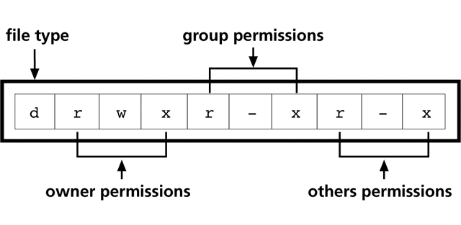
Unix File Permissions (Contd)
Permissions are defined in three sets, for the user (owner), group, and others.
1st character: file type, ‘-’ for file, ‘d’ directory, ‘s’ special, ‘l’ link
Character means permission granted, ‘-’ means denied.

Slide 68
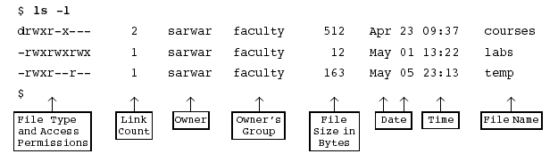
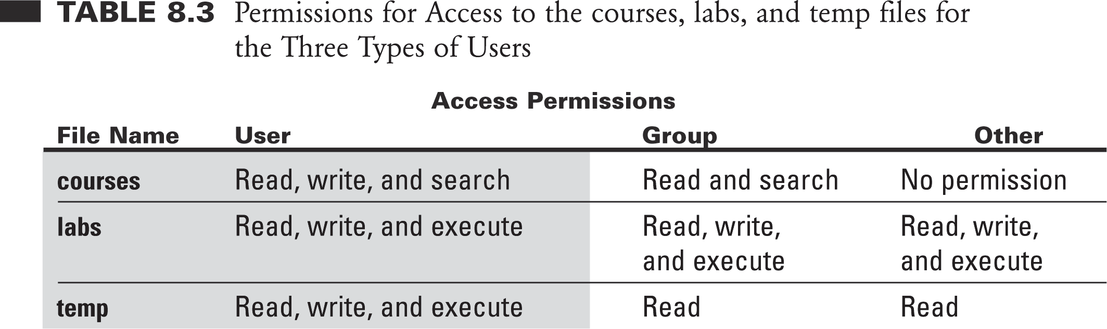
View Permissions

Slide 69
File Permissions: Examples
-rw-------
Only owner can read and write
-rwxrwxrwx
Everyone can read, write and execute (not very common!)
-rw-r--r--
Everyone can read, but only owner can write

Slide 70
Directory Permissions: Examples
drwx------
Only owner can view, delete/create files, and cd into that directory
drwxrwx---
Owner and group can view, create/delete files, cd, etc.
drwxr-xr-x
Everyone can view and cd into, but only owner can modify

Slide 71
Changing Permissions
$ chmod [ugoa(+/-/=)rwx] <dir>
Where
u user, g group, o others, a all (user, group, and others);
+ add permission, - take away permission, = assign permission

Slide 72
Changing Permissions: Examples
Denying execute permission to everyone
chmod a-x file
Making a file readable and writable by the group and other
chmod go+rw file

Slide 73
Changing Permissions (Numeric Approach)
Each access given an octal value
r = read = 4;
w = write = 2;
x = execute = 1
Sum the access for each permission domain
Example:
Approach 1
chmod a+rxw myfile.txt
chmod o-rxw myfile.txt
chmod g-w myfile.txt
Approach 2
chmod 750 myfile.txt
-rwxr-x---
4+2+1
4+1
0
7
5
0

Slide 74
More Examples
To give yourself read & write permission and no permission to anyone else:
chmod 600 foobar.txt
To give yourself read & write permission and everyone else read permission only:
chmod 644 index.html
To give yourself full access to a directory, and everyone else read & execute permission only:
chmod 755 homeDirectory

